Slide 1
CODE APRIL PROJECT
Airline Dataset Analysis

Slide 2
INTRODUCTION
CODE APRIL
PROJECT
OBJECTIVES
CODE APRIL was an initiative that brought people of different backgrounds and coding level together to partake in a 30-day coding challenge.
For each day, there were resources to study and tasks to complete.
To mark the end of the challenge, participants were instructed to pick from two datasets and explore them with certain objectives in mind.
As one of the participants, I chose the Airline Dataset Analysis project.
Explore flight patterns, passenger demographics, and performance metrics.
Discover insights that could influence airline operations and customer experiences.

Slide 3
Challenges deep-dive
1
2
3
Importing Relevant libraries
Pandas, numpy, matplotlib.pyplot, and seaborn were imported.
Importing the dataset
The dataset was in .csv format. Therefore, the .read_csv() method was called to action and the resulting data frame saved as df.
Data Description
The dataset was made up of 15 fields and 98619 records, all non-null.
The information of airline passengers between January and December, 2022

Slide 4
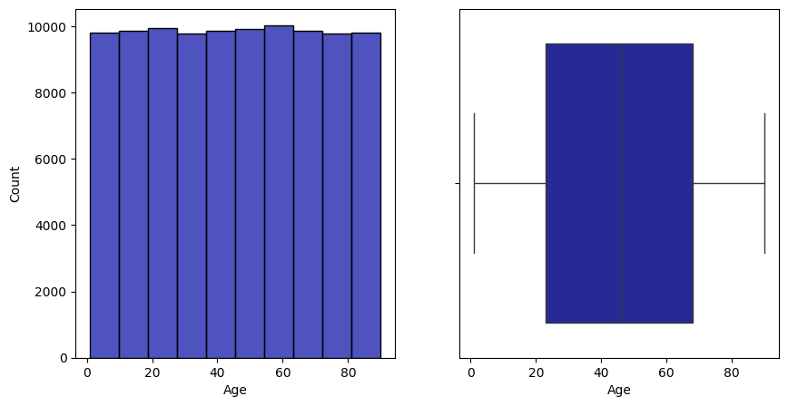
Age Distribution
The histogram shows an almost even distribution across all age ranges.
We have passengers as young as one (1) year and as old as ninety (90) years.
We have a mean age of around fifty (50) years.

Slide 5
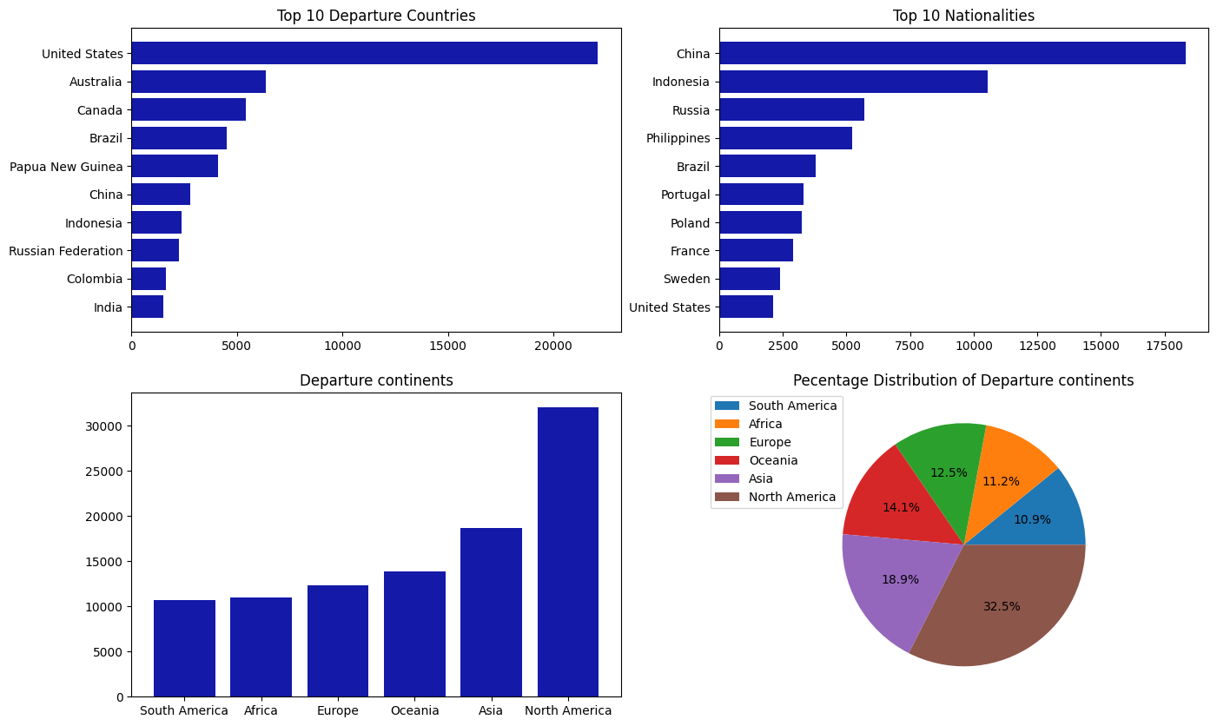
Country of Departure
32.5% of passengers proposed to departed from a North American airport. North America, followed by Asia (18.9%) boosts of the highest passenger departure compared to other continents.
With 10.9% and 11.2% respectively, South American and Africa are the continents having the least amount of passengers proposing to depart from their airports.
Based on the data, the Chinese (18.6%) are the most populous passengers followed by the Indonesians.
Most proposed Departure Country is the United States (22.4%), followed by Australia.

Slide 6
Observation of the ‘Flight Status’ field
There is a column in the dataset tagged Flight Status. This column has the following unique values: 'On Time', 'Delayed', 'Cancelled', as seen from the code above.
It becomes necessary to study trends and know why some flights were delayed, and in extreme cases, why they were cancelled. It will be interesting to know what trends accompanied flights that were on time. These answer will help improve performance and consolidate strong areas.

Slide 7
FURTHER OBSERVATION
The three classes of Flight Statuses are almost evenly distributed.
However, it is a cause for concern that over sixty (60) percent of flights were either delayed or cancelled. This can be simplified by saying that at least six (6) in every ten (10) flights either suffered delay or cancellation.

Slide 8
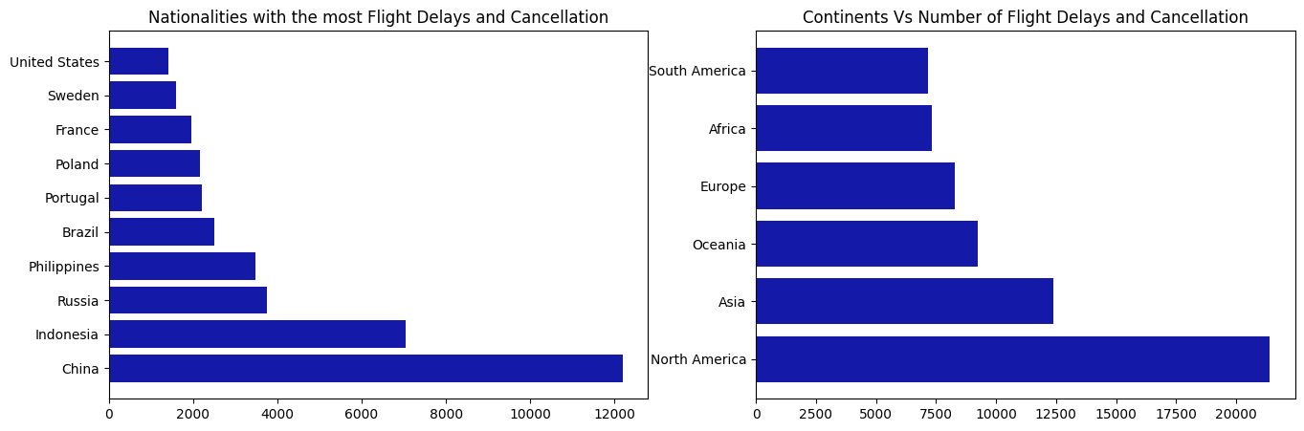
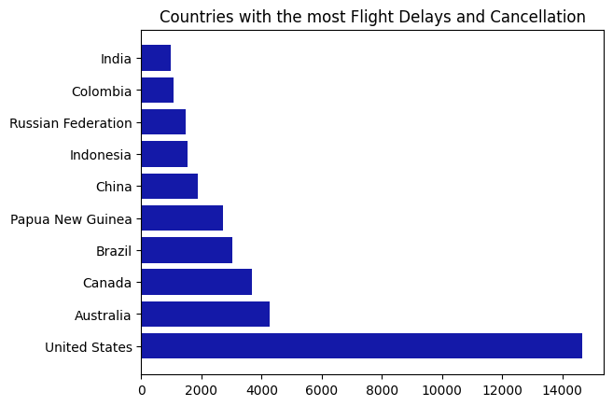

Slide 9
PASSENGER NATIONALITY, DEPARTURE COUNTRY AND CONTINENT.
The number of males and females that either had their flights delayed or cancelled appears to be evenly distributed.
The United States tops departure countries with the most delays or cancellations. The United States accounts for about 22%.
China ranks as the country whose citizens had the most delays or cancellation, constituting about 18%.
The continents of North America and Asia combined, accounts for over fifty (50) percent of delays and cancellations among other continents.

Slide 10
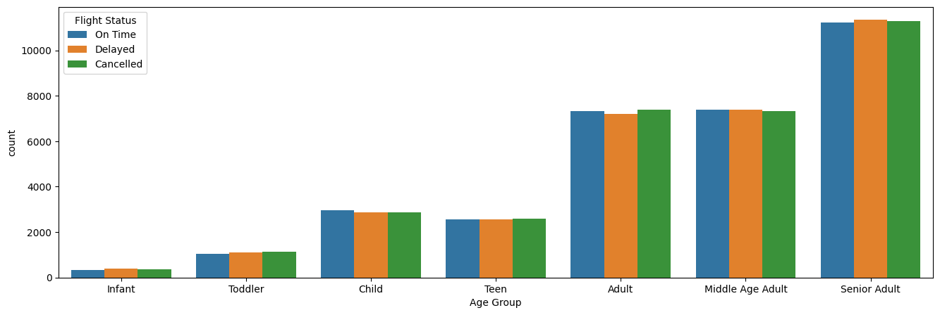
We can see that even across age groups, the flight statuses of passengers are evenly distributed.
Not only that passengers above 60 (senior adults) are more in number, they also had the highest flight delays and cancellation.

Slide 11
CONCLUSION
Based on performance, the airport authorities have to do more. How can a whooping 60% of total proposed flight either end up delayed or cancelled?
`
If the authorities in North America and Asia can address reasons why their airports account for over 50% of delays and cancellation, that will go a long way to nip this problem in the bud.
The authorities can start by answering the following questions:
Are there peculiarities surrounding passengers over 60 which results in their flight been delayed or cancelled?
Are there issues been overlooked by authorities in United States airports resulting in such a high percentage of delays or cancellation?
What are the circumstances that made that many Chinese citizens have delays and cancellations?

Slide 12
THANK YOU!

